Slide 1
Mathematical Foundations for Data Science
MFDS Team

Slide 2
DSECL ZC416, MFDS
Lecture No. 11

Slide 3
Agenda
Mathematical Induction
Examples of Proof by Mathematical Induction
Mistaken Proofs by Mathematical Induction
Guidelines for Proofs by Mathematical Induction
Strong Induction
Example Proofs using Strong Induction
Well-Ordering Property

Slide 4
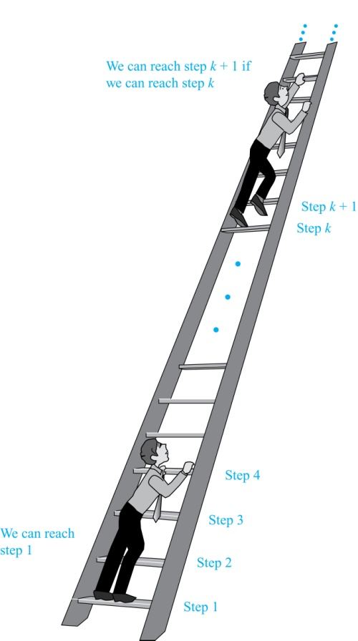
Mathematical Induction
Climbing an Infinite Ladder
Suppose we have an infinite ladder:
We can reach the first rung of the ladder.
If we can reach a particular rung of the ladder, then we can reach the next rung.
From (1), we can reach the first rung. Then by applying (2), we can reach the second rung. Applying (2) again, the third rung. And so on. We can apply (2) any number of times to reach any particular rung, no matter how high up.
This example motivates proof by mathematical induction.

Slide 5
Principle of Mathematical Induction
Principle of Mathematical Induction: To prove that P(n) is true for all positive integers n, we complete these steps:
  Basis Step: Show that P(1) is true.
  Inductive Step: Show that P(k) → P(k + 1) is true for all positive integers k.
To complete the inductive step, assuming the inductive hypothesis that P(k) holds for an arbitrary integer k, show that P(k + 1) must be true.
Climbing an Infinite Ladder Example:
  BASIS STEP: By (1), we can reach rung 1.
  INDUCTIVE STEP: Assume the inductive hypothesis that we can reach rung k. Then by (2), we can reach rung k + 1.
Hence, P(k) → P(k + 1) is true for all positive integers k. We can reach every rung on the ladder.

Slide 6
Important Points About Using Mathematical Induction
Mathematical induction can be expressed as the rule of inference
where the domain is the set of positive integers.
In a proof by mathematical induction, we don’t assume that P(k) is true for all positive integers! We show that if we assume that P(k) is true, then P(k + 1) must also be true.
Proofs by mathematical induction do not always start at the integer 1. In such a case, the basis step begins at a starting point b where b is an integer. We will see examples of this soon.
(P(1) ∧ ∀k (P(k) → P(k + 1))) → ∀n P(n),

Slide 7
Validity of Mathematical Induction
Mathematical induction is valid because of the well ordering property, which states that every nonempty subset of the set of positive integers has a least element. Here is the proof:
  Suppose that P(1) holds and P(k) → P(k + 1) is true for all positive integers k.
  Assume there is at least one positive integer n for which P(n) is false. Then the set S of positive integers for which P(n) is false is nonempty.
  By the well-ordering property, S has a least element, say m.
  We know that m can not be 1 since P(1) holds.
  Since m is positive and greater than 1, m − 1 must be a positive integer. Since m − 1 < m, it is not in S, so P(m − 1) must be true.
  But then, since the conditional P(k) → P(k + 1) for every positive integer k holds, P(m) must also be true. This contradicts P(m) being false.
  Hence, P(n) must be true for every positive integer n.

Slide 8
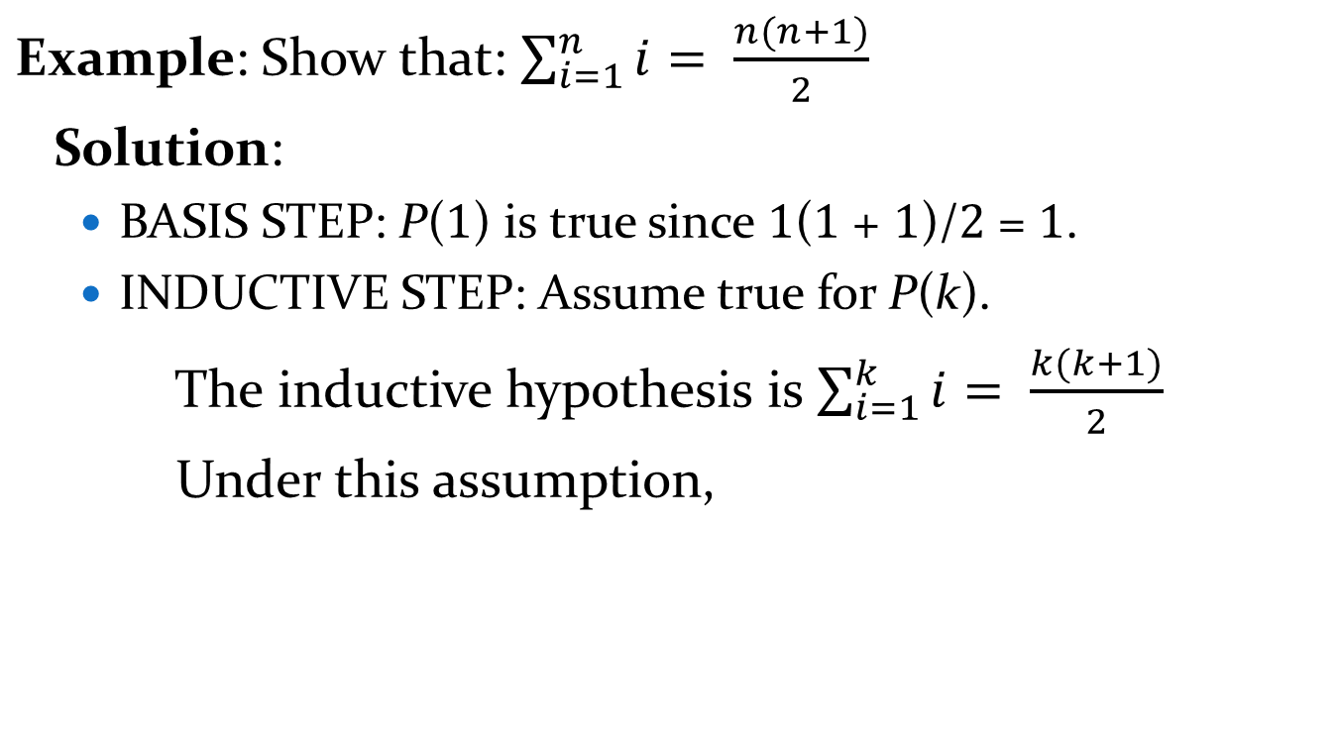
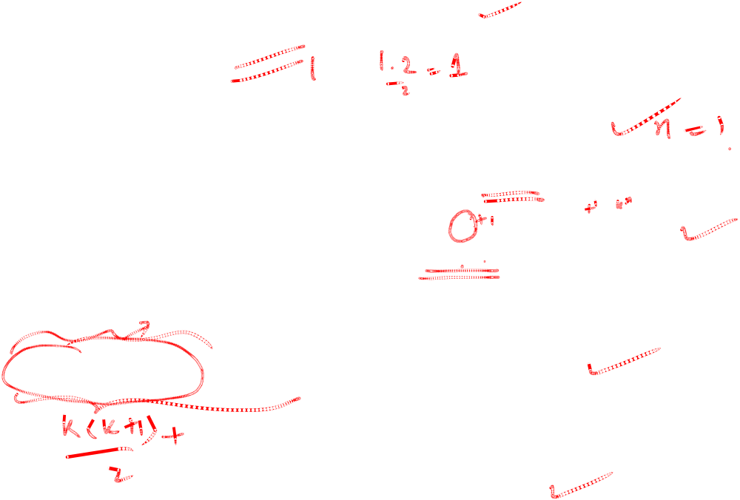
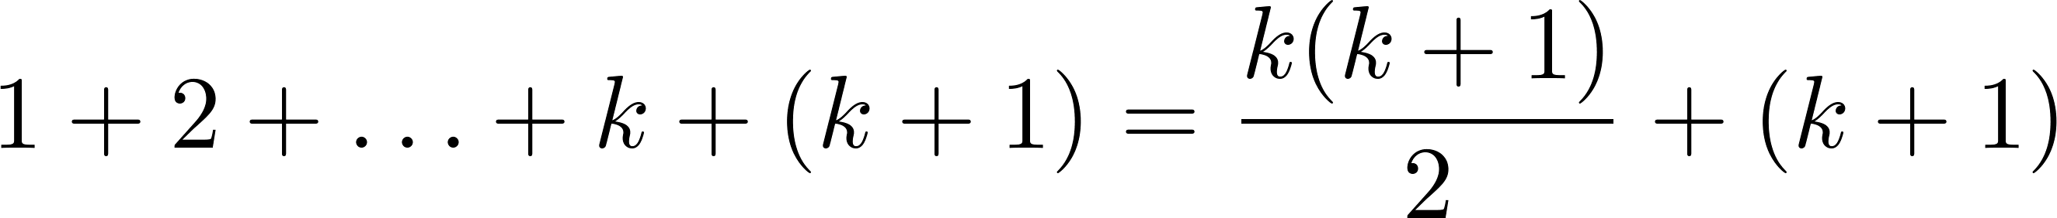
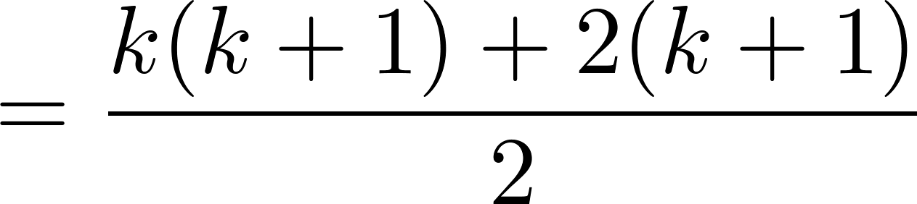
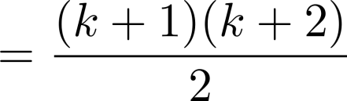
Proving a Summation Formula by Mathematical Induction
Note: Once we have this conjecture, mathematical induction can be used to prove it correct.

Slide 9

Conjecturing and Proving Correct a Summation Formula
Example: Conjecture and prove correct a formula for the sum of the first n positive odd integers. Then prove your conjecture.
Solution: We have: 1= 1, 1 + 3 = 4, 1 + 3 + 5 = 9, 1 + 3 + 5 + 7 = 16, 1 + 3 + 5 + 7 + 9 = 25.
  We can conjecture that the sum of the first n positive odd integers is n²,
  We prove the conjecture is proved correct with mathematical induction.
  BASIS STEP: P(1) is true since 1² = 1.
  INDUCTIVE STEP: P(k) → P(k + 1) for every positive integer k.
Assume the inductive hypothesis holds and then show that P(k + 1) holds has well.
  So, assuming P(k), it follows that:
  Hence, we have shown that P(k + 1) follows from P(k). Therefore the sum of the first n positive odd integers is n².
1 + 3 + 5 + ∙∙∙+ (2n − 1) + (2n + 1) =n² .
Inductive Hypothesis: 1 + 3 + 5 + ∙∙∙+ (2k − 1) =k²
1 + 3 + 5 + ∙∙∙+ (2k − 1) + (2k + 1) =[1 + 3 + 5 + ∙∙∙+ (2k − 1)] + (2k + 1)
= k² + (2k + 1) (by the inductive hypothesis)
= k² + 2k + 1
= (k + 1) ²

Slide 10
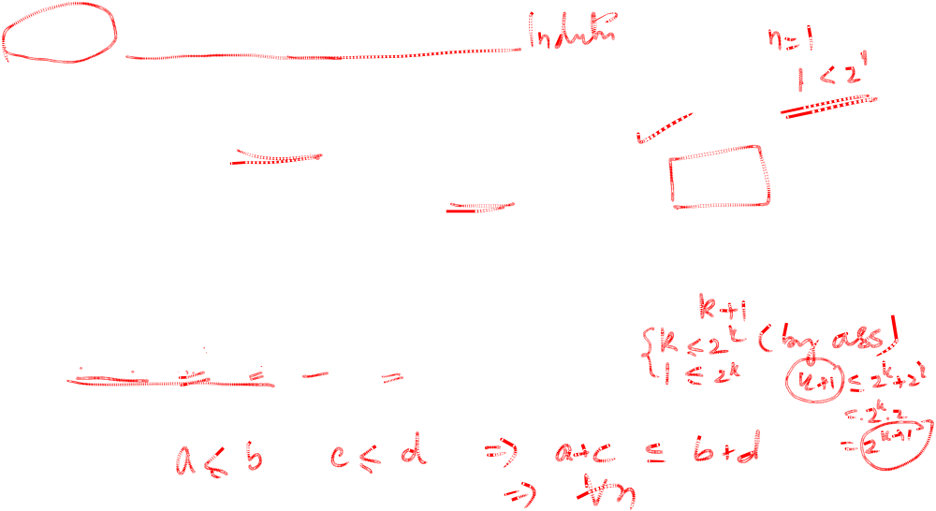
Proving Inequalities
Example: Use mathematical induction to prove that n < 2^{n} for all positive integers n.
Solution: Let P(n) be the proposition that n < 2^{n}.
  BASIS STEP: P(1) is true since 1 < 2¹ = 2.
  INDUCTIVE STEP: Assume P(k) holds, i.e., k < 2^{k}, for an arbitrary positive integer k.
  Must show that P(k + 1) holds. Since by the inductive hypothesis, k < 2^{k}, it follows that:
  k + 1 < 2^{k} + 1 ≤ 2^{k} + 2^{k} = 2 ∙ 2^{k} = 2^{k+1}
Therefore n < 2^{n} holds for all positive integers n.

Slide 11


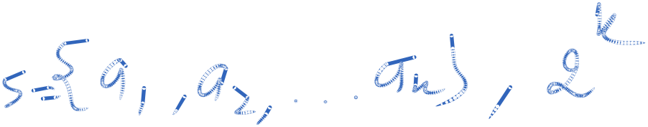
Number of Subsets of a Finite Set
Example: Use mathematical induction to show that if S is a finite set with n elements, where n is a nonnegative integer, then S has 2^{n} subsets.
Solution: Let P(n) be the proposition that a set with n elements has 2^{n} subsets.
  Basis Step: P(0) is true, because the empty set has only itself as a subset and 2⁰ = 1.
  Inductive Step: Assume P(k) is true for an arbitrary nonnegative integer k.

Slide 12
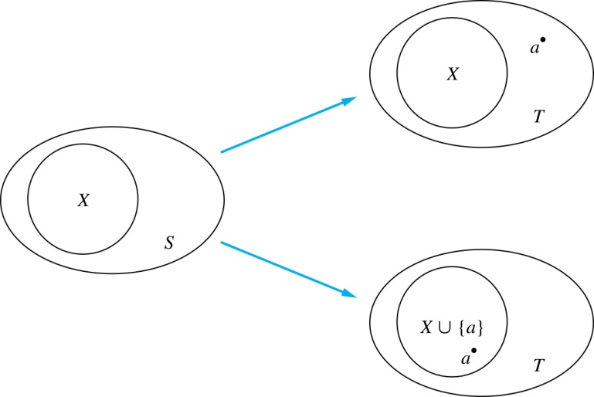
Number of Subsets of a Finite Set
    Let T be a set with k + 1 elements. Then T = S ∪ {a}, where a ∈ T and S = T − {a}. Hence |S| = k.
    For each subset X of S, there are exactly two subsets of T, i.e., X and X ∪ {a}.
    By the inductive hypothesis S has 2^{k} subsets. Since there are two subsets of T for each subset of S, the number of subsets of T is 2 ∙2^{k} = 2^{k+1} .
Inductive Hypothesis: For an arbitrary nonnegative integer k, every set with k elements has 2^{k} subsets.

Slide 13
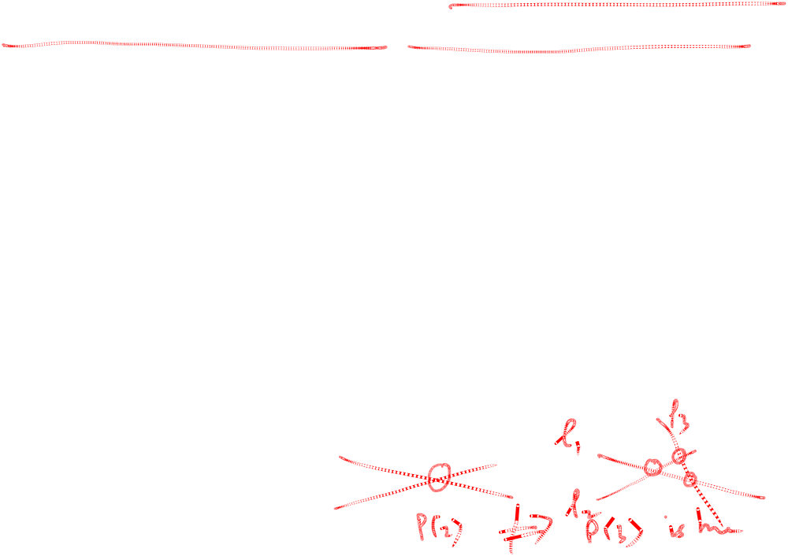
An Incorrect “Proof” by Mathematical Induction
Example: Let P(n) be the statement that every set of n lines in the plane, no two of which are parallel, meet in a common point. Here is a “proof” that P(n) is true for all positive integers n ≥ 2.
  BASIS STEP: The statement P(2) is true because any two lines in the plane that are not parallel meet in a common point.
  INDUCTIVE STEP: The inductive hypothesis is the statement that P(k) is true for the positive integer k ≥ 2, i.e., every set of k lines in the plane, no two of which are parallel, meet in a common point.
  We must show that if P(k) holds, then P(k + 1) holds, i.e., if every set of k lines in the plane, no two of which are parallel, k ≥ 2, meet in a common point, then every set of k + 1 lines in the plane, no two of which are parallel, meet in a common point.

Slide 14
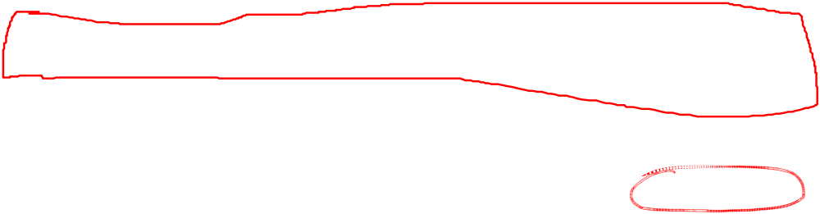
An Incorrect “Proof” by Mathematical Induction
Inductive Hypothesis: Every set of k lines in the plane, where k ≥ 2, no two of which are parallel, meet in a common point.
  Consider a set of k + 1 distinct lines in the plane, no two parallel. By the inductive hypothesis, the first k of these lines must meet in a common point p₁. By the inductive hypothesis, the last k of these lines meet in a common point p₂.
  If p₁ and p₂ are different points, all lines containing both of them must be the same line since two points determine a line. This contradicts the assumption that the lines are distinct. Hence, p₁ = p₂ lies on all k + 1 distinct lines, and therefore P(k + 1) holds. Assuming that k ≥2, distinct lines meet in a common point, then every k + 1 lines meet in a common point.
  There must be an error in this proof since the conclusion is absurd. But where is the error?
    Answer: P(k)→ P(k + 1) only holds for k ≥3. It is not the case that P(2) implies P(3). The first two lines must meet in a common point p₁ and the second two must meet in a common point p₂. They do not have to be the same point since only the second line is common to both sets of lines.

Slide 15
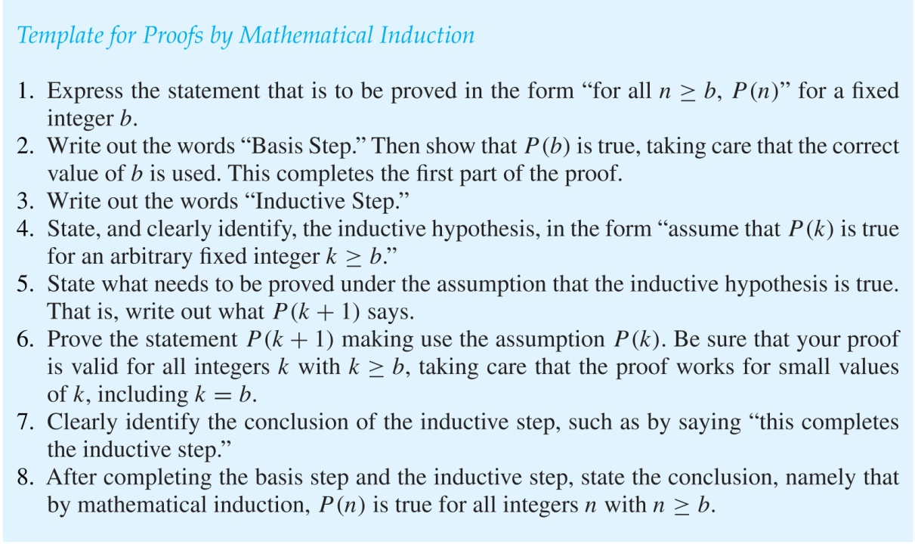
Guidelines:
Mathematical Induction Proofs

Slide 16
Strong Induction
Strong Induction: To prove that P(n) is true for all positive integers n, where P(n) is a propositional function, complete two steps:
  Basis Step: Verify that the proposition P(1) is true.
  Inductive Step: Show the conditional statement [P(1) ∧ P(2) ∧∙∙∙ ∧ P(k)] → P(k + 1) holds for all positive integers k.
Strong Induction is sometimes called the second principle of mathematical induction or complete induction.

Slide 17
Strong Induction and the Infinite Ladder
Strong induction tells us that we can reach all rungs if:
We can reach the first rung of the ladder.
For every integer k, if we can reach the first k rungs, then we can reach the (k + 1)st rung.
To conclude that we can reach every rung by strong induction:
BASIS STEP: P(1) holds
INDUCTIVE STEP: Assume P(1) ∧ P(2) ∧∙∙∙ ∧ P(k)
holds for an arbitrary integer k, and show that
P(k + 1) must also hold.
We will have then shown by strong induction that for every positive integer n, P(n) holds, i.e., we can
reach the nth rung of the ladder.

Slide 18
Proof using Strong Induction
Example: Suppose we can reach the first and second rungs of an infinite ladder, and we know that if we can reach a rung, then we can reach two rungs higher. Prove that we can reach every rung.
(Try this with mathematical induction.)
Solution: Prove the result using strong induction.
  BASIS STEP: We can reach the first step.
  INDUCTIVE STEP: The inductive hypothesis is that we can reach the first k rungs, for any k ≥ 2. We can reach the (k + 1)st rung since we can reach the (k − 1)st rung by the inductive hypothesis.
  Hence, we can reach all rungs of the ladder.

Slide 19
Which Form of Induction Should Be Used?
We can always use strong induction instead of mathematical induction. But there is no reason to use it if it is simpler to use mathematical induction.
In fact, the principles of mathematical induction, strong induction, and the well-ordering property are all equivalent.
Sometimes it is clear how to proceed using one of the three methods, but not the other two.

Slide 20
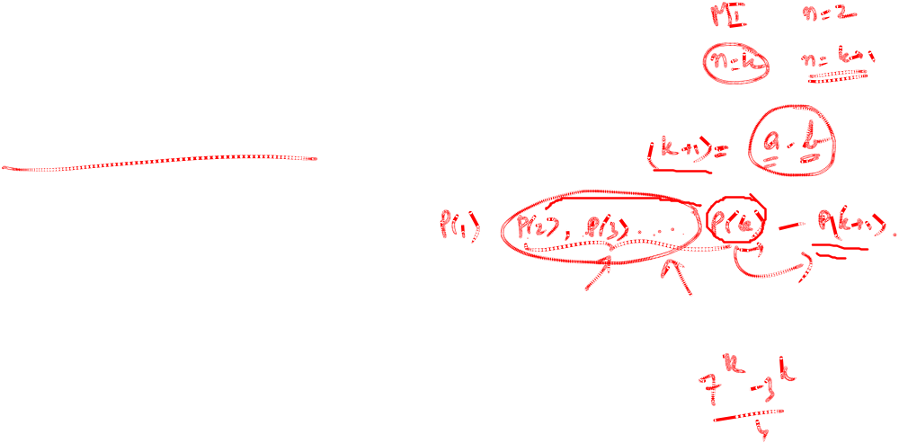
Completion of the proof of the Fundamental Theorem of Arithmetic
Example: Show that if n is an integer greater than 1, then n can be written as the product of primes.
Solution: Let P(n) be the proposition that n can be written as a product of primes.
  BASIS STEP: P(2) is true since 2 itself is prime.
  INDUCTIVE STEP: The inductive hypothesis is P(j) is true for all integers j with 2 ≤ j ≤ k. To show that P(k + 1) must be true under this assumption, two cases need to be considered:
    If k + 1 is prime, then P(k + 1) is true.
    Otherwise, k + 1 is composite and can be written as the product of two positive integers a and b with 2 ≤ a ≤ b < k + 1. By the inductive hypothesis a and b can be written as the product of primes and therefore k + 1 can also be written as the product of those primes.
Hence, it has been shown that every integer greater than 1 can be written as the product of primes.

Slide 21
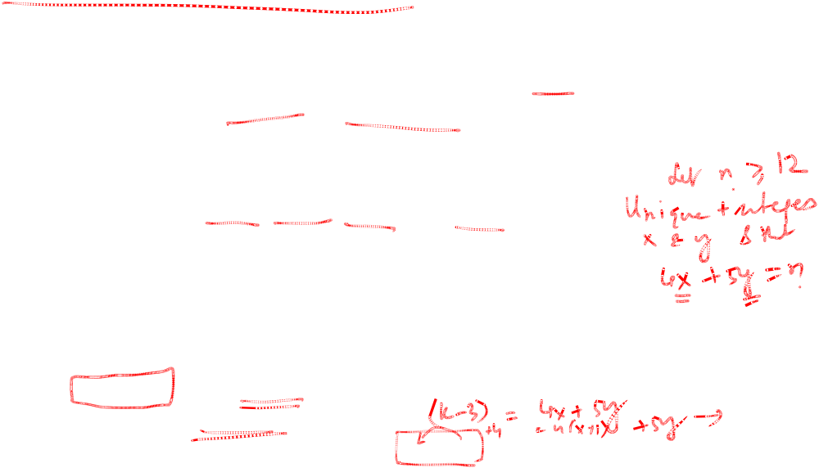
Proof using Strong Induction
Example: Prove that every amount of postage of 12 cents or more can be formed using just 4-cent and 5-cent stamps.
Solution: Let P(n) be the proposition that postage of n cents can be formed using 4-cent and 5-cent stamps.
  BASIS STEP: P(12), P(13), P(14), and P(15) hold.
    P(12) uses three 4-cent stamps.
    P(13) uses two 4-cent stamps and one 5-cent stamp.
    P(14) uses one 4-cent stamp and two 5-cent stamps.
    P(15) uses three 5-cent stamps.
  INDUCTIVE STEP: The inductive hypothesis states that P(j) holds for 12 ≤ j ≤ k, where k ≥ 15. Assuming the inductive hypothesis, it can be shown that P(k + 1) holds.
  Using the inductive hypothesis, P(k − 3) holds since k − 3 ≥ 12. To form postage of k + 1 cents, add a 4-cent stamp to the postage for k − 3 cents.
Hence, P(n) holds for all n ≥ 12.

Slide 22
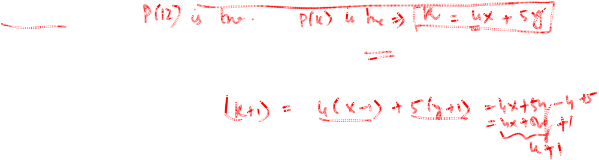
Proof of Same Example using Mathematical Induction
Example: Prove that every amount of postage of 12 cents or more can be formed using just 4-cent and 5-cent stamps.
Solution: Let P(n) be the proposition that postage of n cents can be formed using 4-cent and 5-cent stamps.
  BASIS STEP: Postage of 12 cents can be formed using three 4-cent stamps.
  INDUCTIVE STEP: The inductive hypothesis P(k) for any positive integer k is that postage of k cents can be formed using 4-cent and 5-cent stamps. To show P(k + 1) where k ≥ 12 , we consider two cases:
    If at least one 4-cent stamp has been used, then a 4-cent stamp can be replaced with a 5-cent stamp to yield a total of k + 1 cents.
    Otherwise, no 4-cent stamp have been used and at least three 5-cent stamps were used. Three 5-cent stamps can be replaced by four 4-cent stamps to yield a total of k + 1 cents.
Hence, P(n) holds for all n ≥ 12.

Slide 23
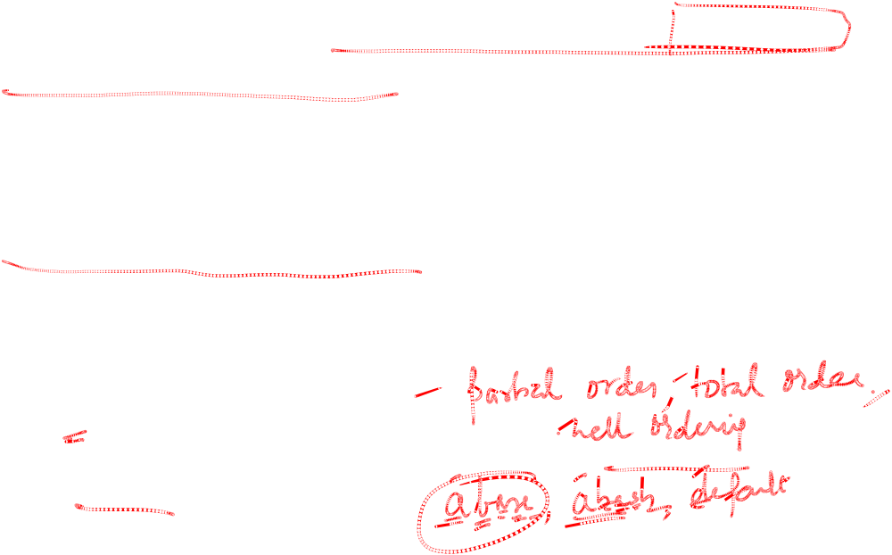
Well-Ordering Property
Well-ordering property: Every nonempty set of nonnegative integers has a least element.
The well-ordering property is one of the axioms of the positive integers.
The well-ordering property can be used directly in proofs, as the next example illustrates.
The well-ordering property can be generalized.
  Definition: A set is well ordered if every subset has a least element.
    N is well ordered under ≤.
    The set of finite strings over an alphabet using lexicographic ordering is well ordered.

Slide 24
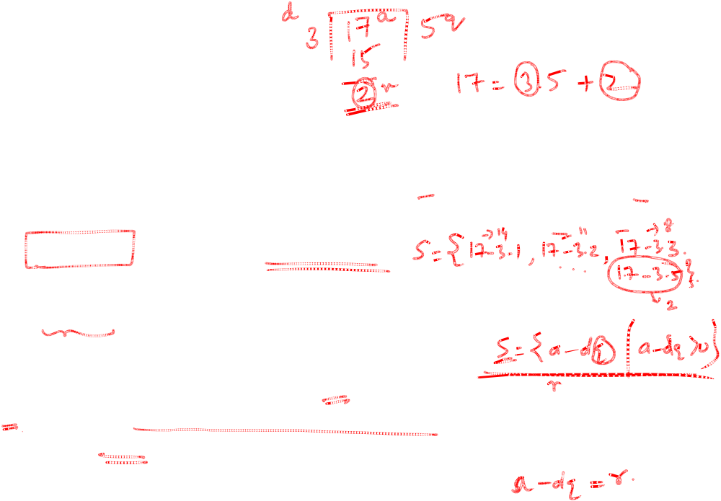
Well-Ordering Property
Example: Use the well-ordering property to prove the division algorithm, which states that if a is an integer and d is a positive integer, then there are unique integers q and r with 0 ≤ r < d, such that a = dq + r.
Solution: Let S be the set of nonnegative integers of the form a − dq, where q is an integer. The set is nonempty since −dq can be made as large as needed.
  By the well-ordering property, S has a least element r = a − dq₀. The integer r is nonnegative. It also must be the case that r < d. If it were not, then there would be a smaller nonnegative element in S, namely, a − d(q₀ + 1) = a − dq₀ − d = r − d > 0.
  Therefore, there are integers q and r with 0 ≤ r < d.

